Slide 1
Online Permitting And Licensing
Citizen Self Service Portal
On the websites Permits and Licensing home page, select the link for the:
“Citizen Self Service Portal”

Slide 2
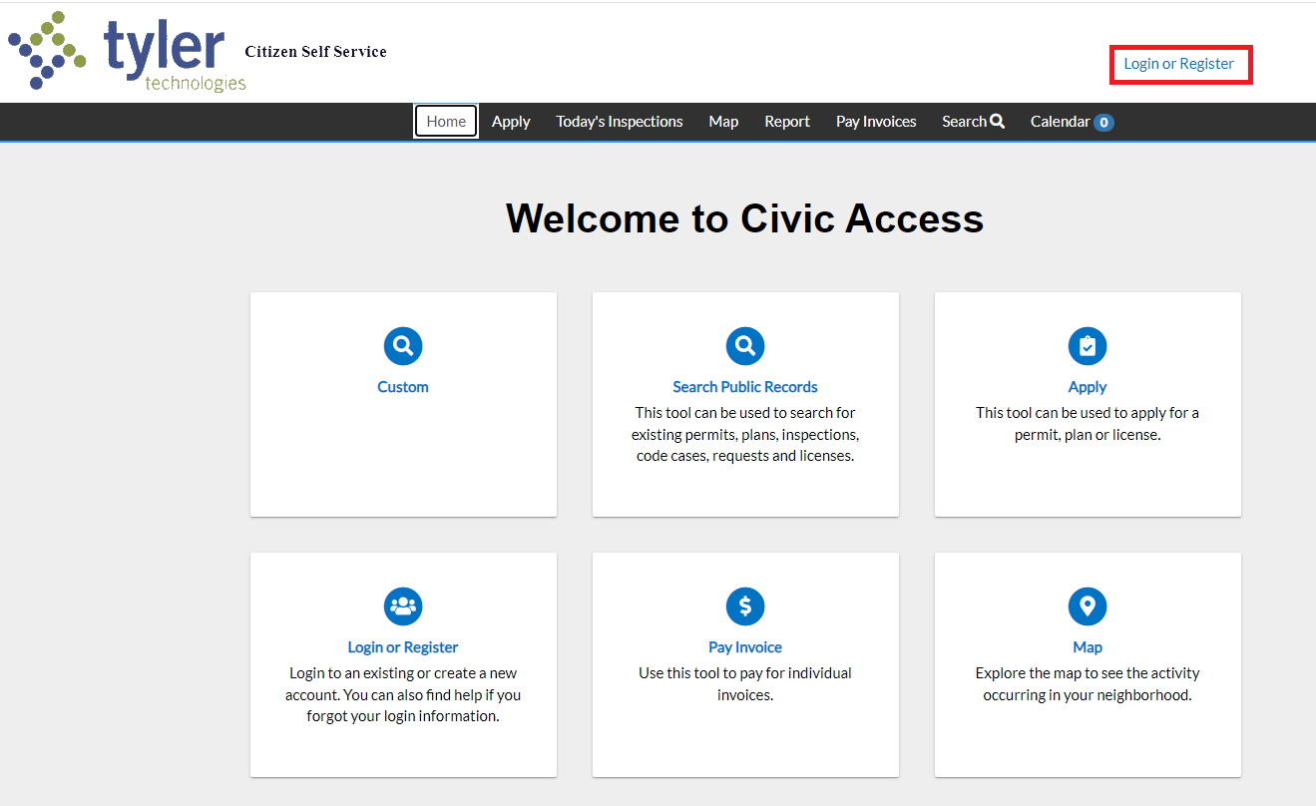
Citizen Self Service portal in Civic Access
Log into your Citizen Self Service portal to access your permits

Slide 3
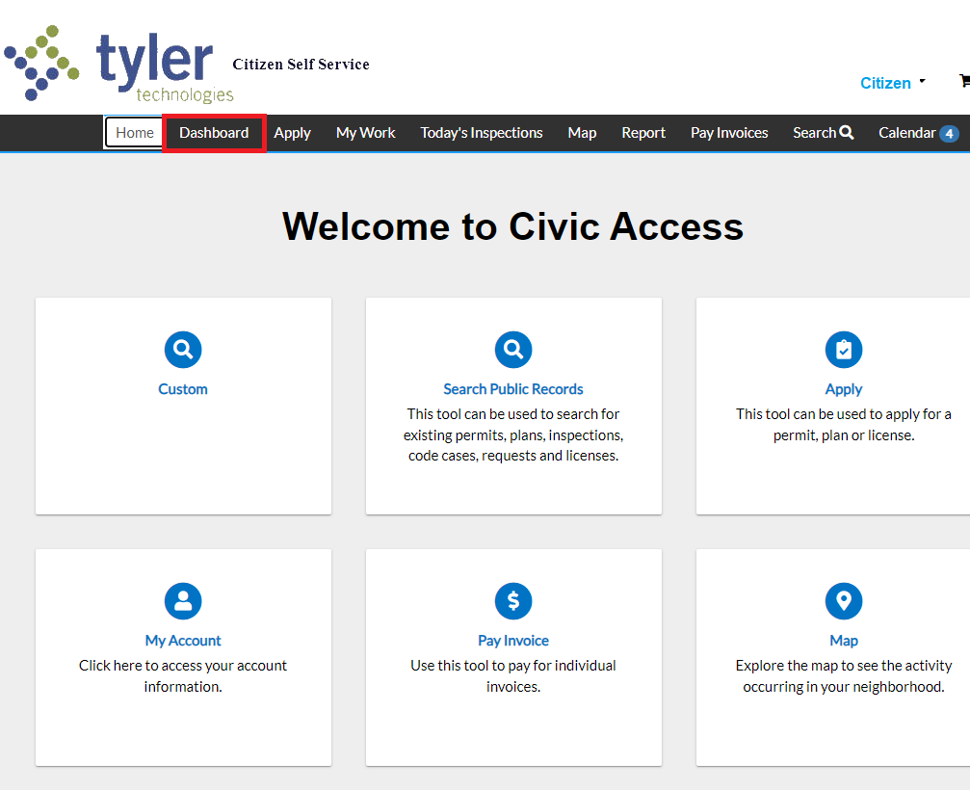
Citizen Self Service Portal
Accessing the Dashboard
Once logged in to your Civic Access portal account, select “Dashboard” from the top menu bar

Slide 4
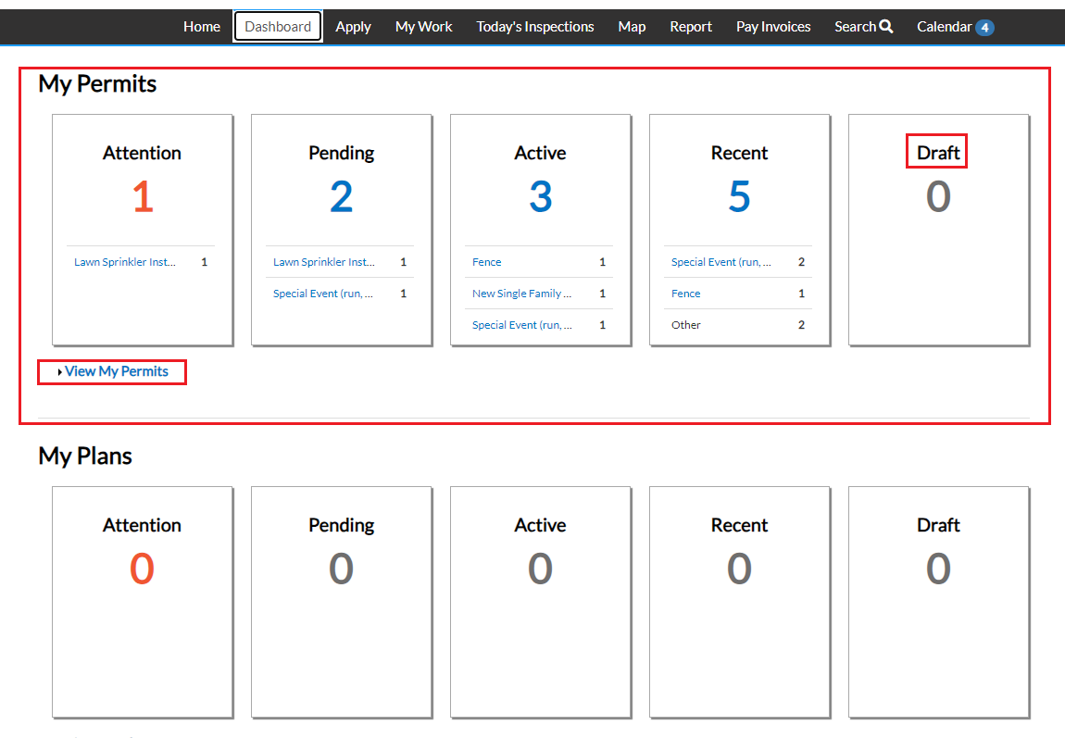
Citizen Self Service Portal
Dashboard
All permit applications submitted to the Village will be appear on your Dashboard, click “View My Permits”
NOTE: All communication with the Village can take place through the Citizen Self Service Portal

Slide 5
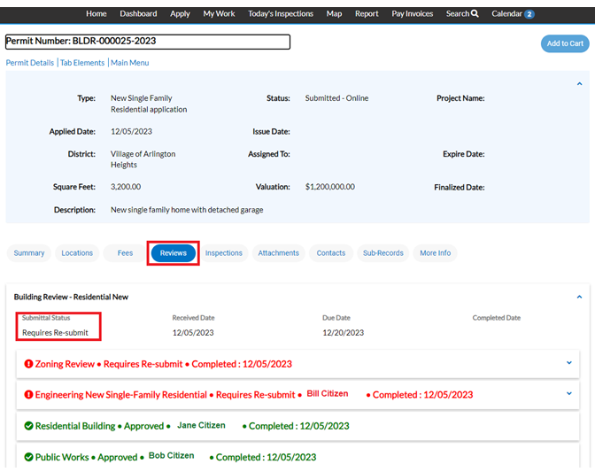
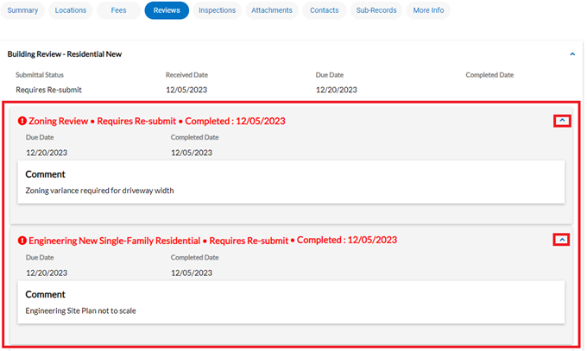
Citizen Self Service Permit Management
Step 1: Permit Review Process
Individual reviews completed by Village staff are available in the “Review” tab
NOTE: Reviews requiring re-submittal will appear in red, reviews approved will appear in green

Slide 6
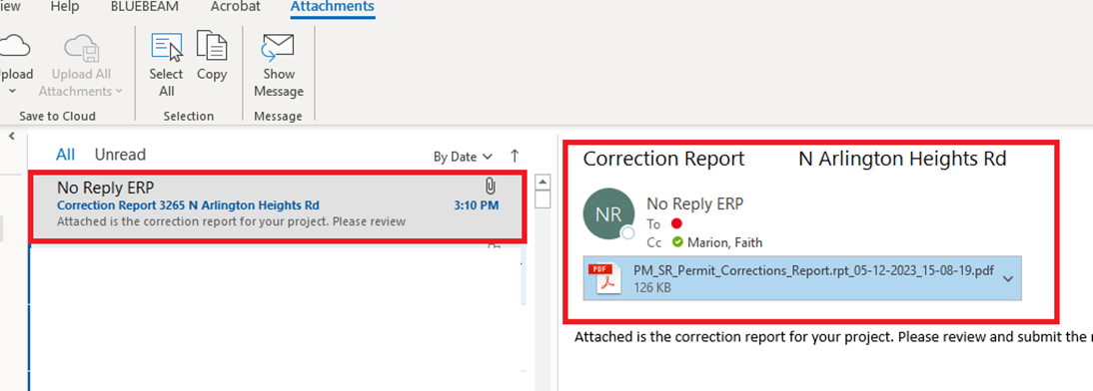
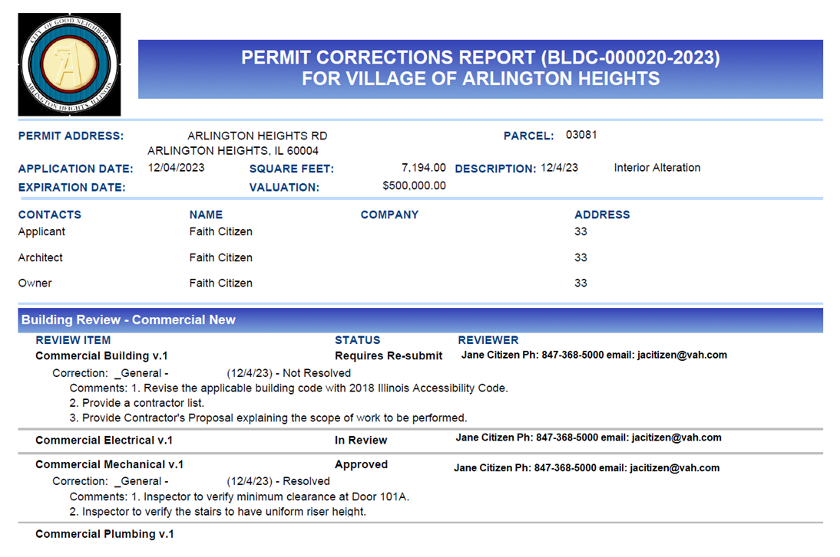
Citizen Self Service Permit Management
Step 1: Permit Review Process cont.
Once all reviews are complete, a Corrections Report compiling all review comments will be emailed to the applicant
NOTE: Resubmittal will require a written disposition to each review comment

Slide 7
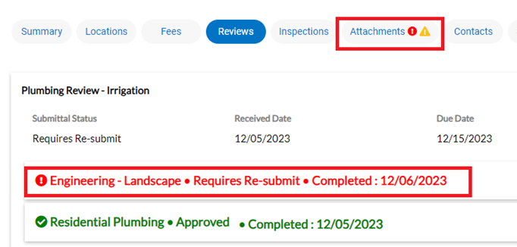
Citizen Self Service Permit Management
Step 2: Submitting Revisions
Required Re-submittals will appear in the Attachments tab
NOTE: There are several steps to the re-submittal process

Slide 8
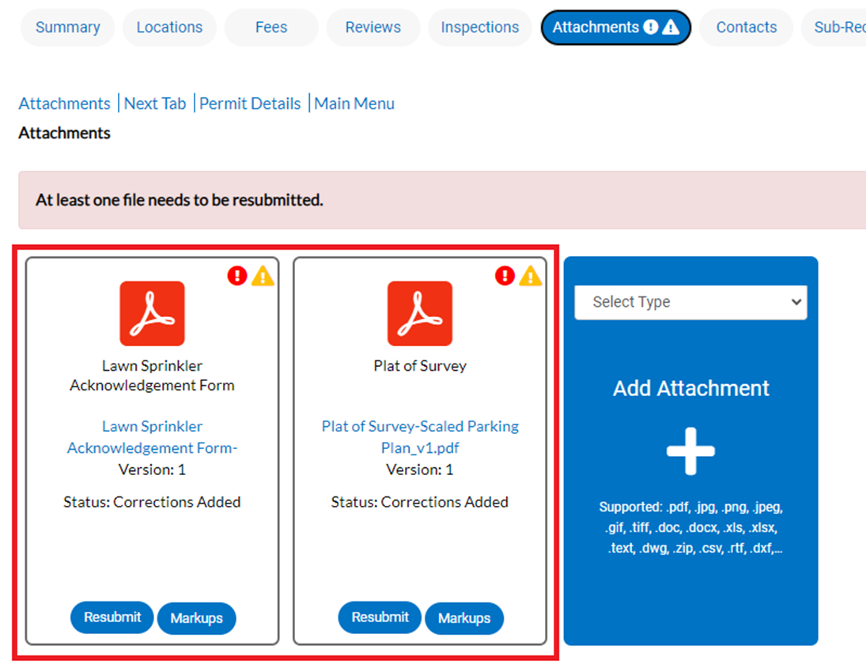
Citizen Self Service Permit Management
Step 2: Submitting Revisions cont.
Begin the re-submittal process by selecting “Resubmit”
NOTE: Review comments can be viewed by selecting “Markups”

Slide 9
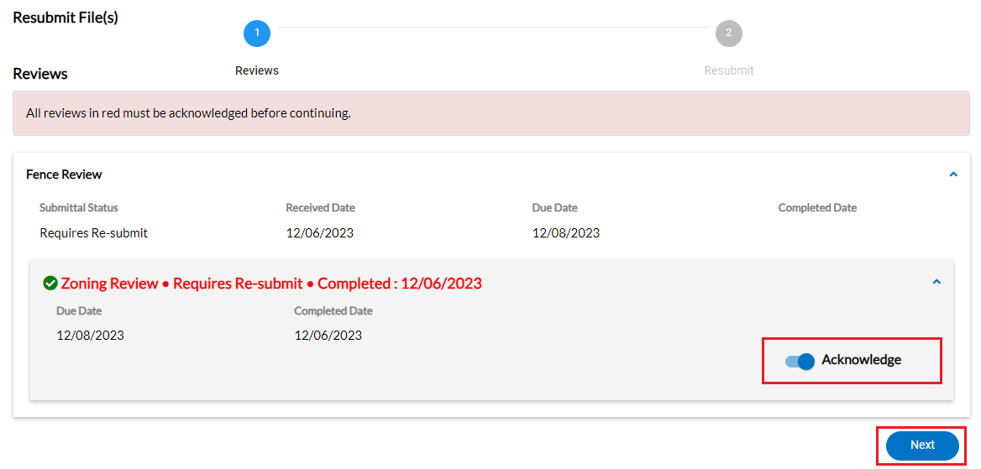
Citizen Self Service Permit Management
Step 2: Submitting Revisions cont.
Acknowledge the re-submittal requirement, click “Next” to continue

Slide 10
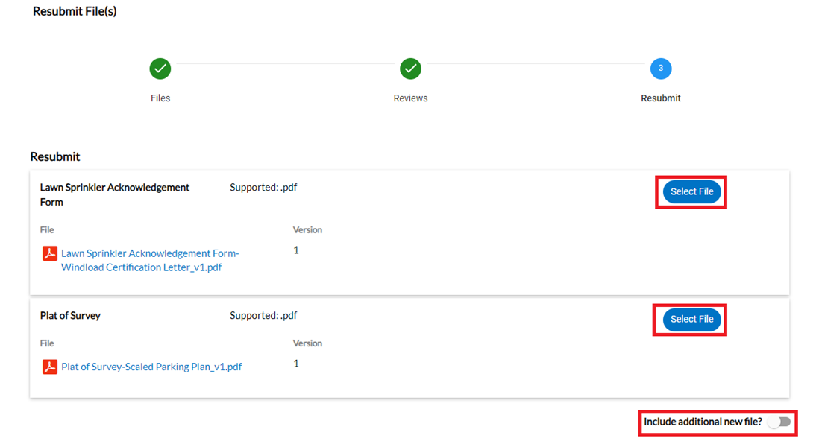
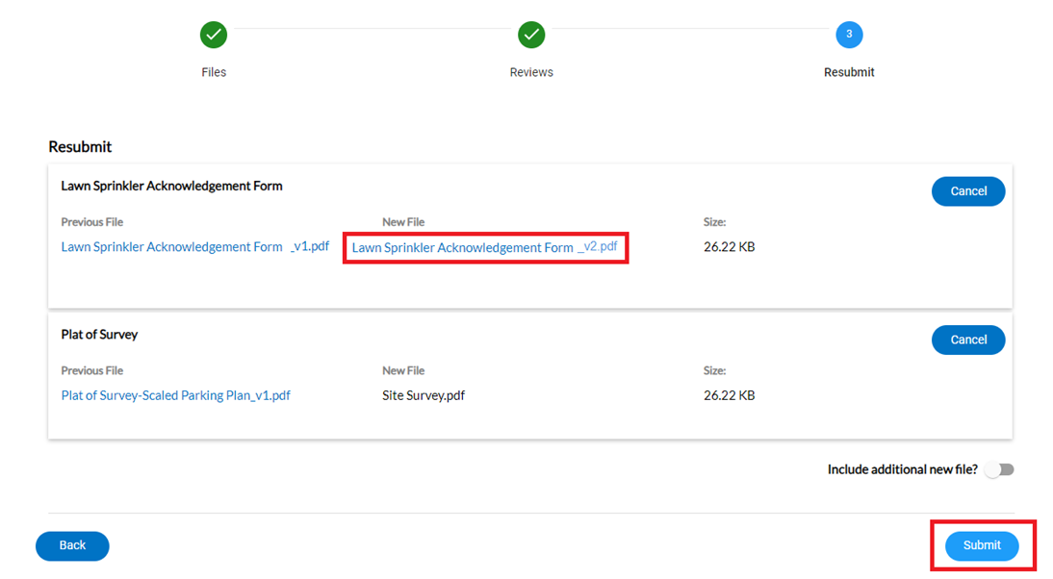
Citizen Self Service Permit Management
Step 2: Submitting Revisions cont.
Select the files to be uploaded, click “Submit” to complete the re-submittal process
NOTE: Additional supporting documents, including the disposition of comments, can be uploaded

Slide 11
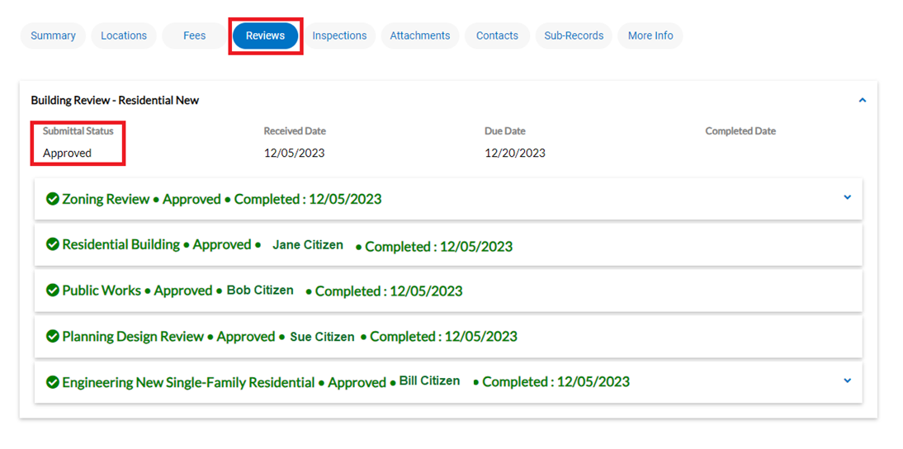
Citizen Self Service Permit Management
Step 3: Permit Approved
Re-submittal review process:
Re-submitted documents will be reviewed
If additional revisions required, the re-submittal process will be repeated
Once all reviews have been approved, the Submittal Status will reflect “Approved”
Permit technicians will review pricing
Fees invoiced to Applicant

Slide 12
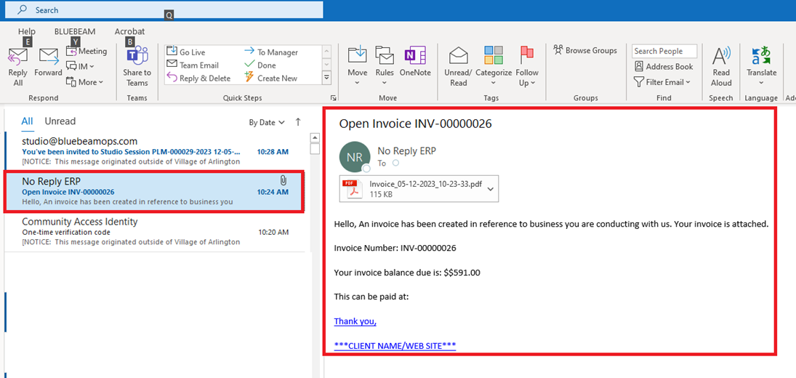
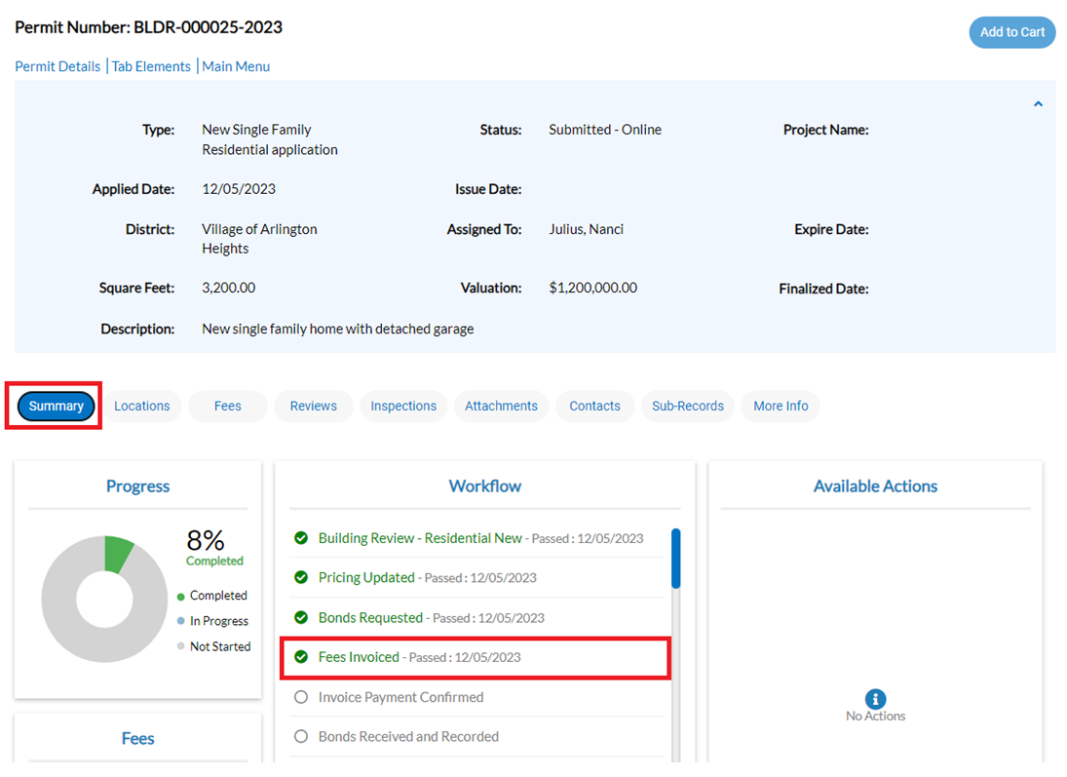
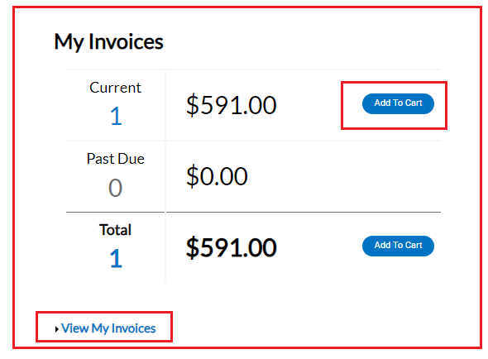
Citizen Self Service Permit Management
Step 4: Permit Invoice
Invoice will be available on your Dashboard and sent via email
To pay invoice, select “Add to Cart”

Slide 13
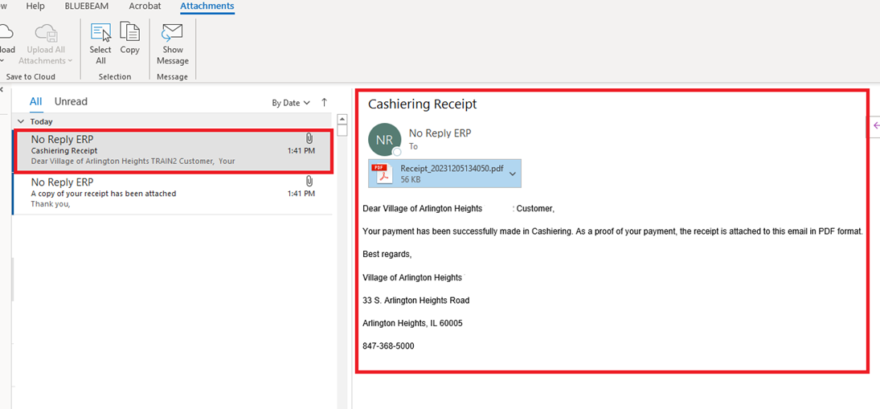
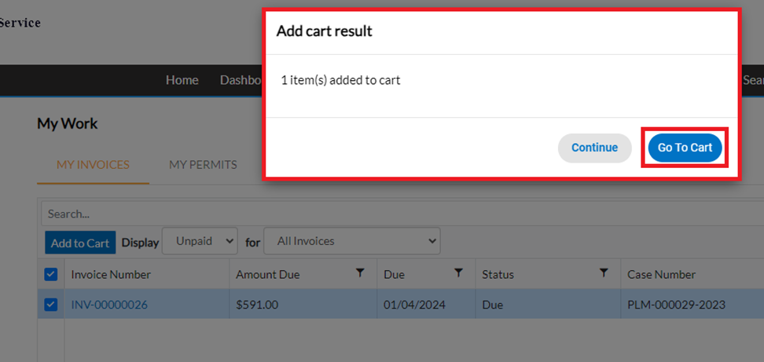
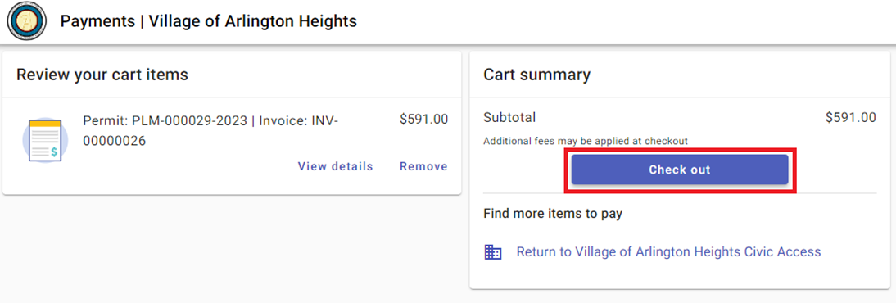
Citizen Self Service Permit Management
Step 4: Permit Invoice cont.
Select “Go To Cart” and “Check Out”
A Cashiering Receipt will be sent via email

Slide 14
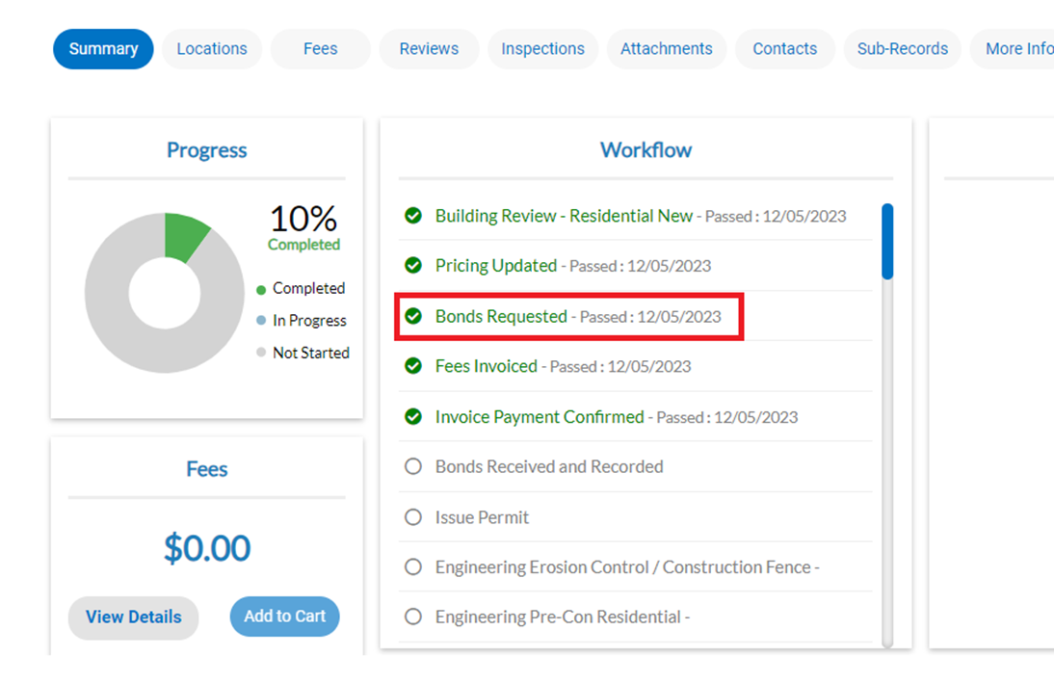
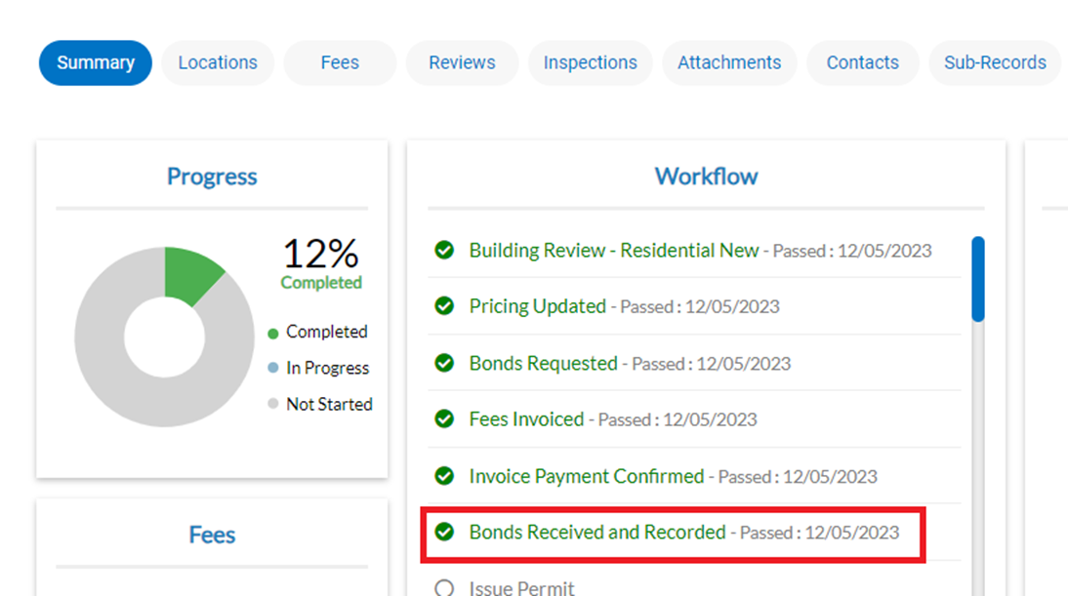
Citizen Self Service Permit Management
Step 5: Bonds
Bonds will be requested, the workflow will reflect once the bonds have been received and recorded

Slide 15
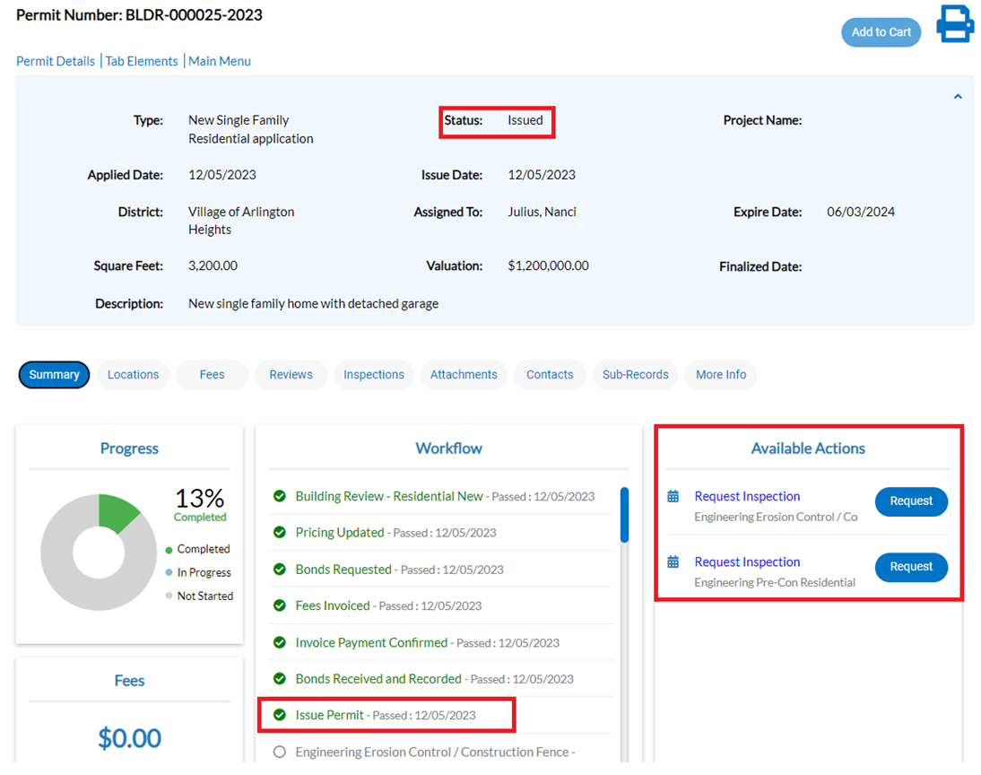
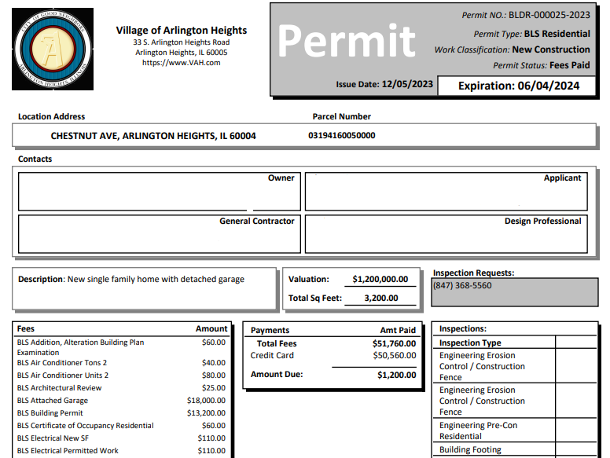
Citizen Self Service Permit Management
Step 6: Issue Permit
The previous six Workflow steps are complete and the permit is ready to be issued
NOTE: Click the printer icon to view and print your permit

Slide 16
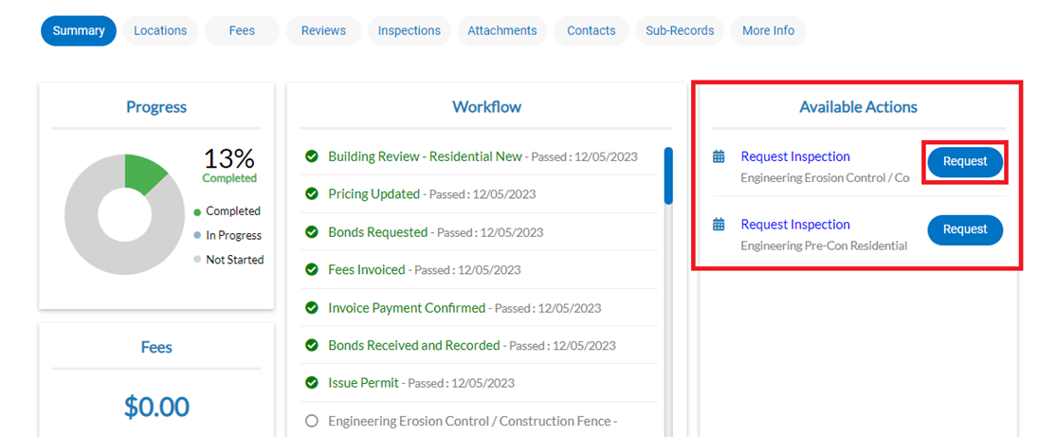
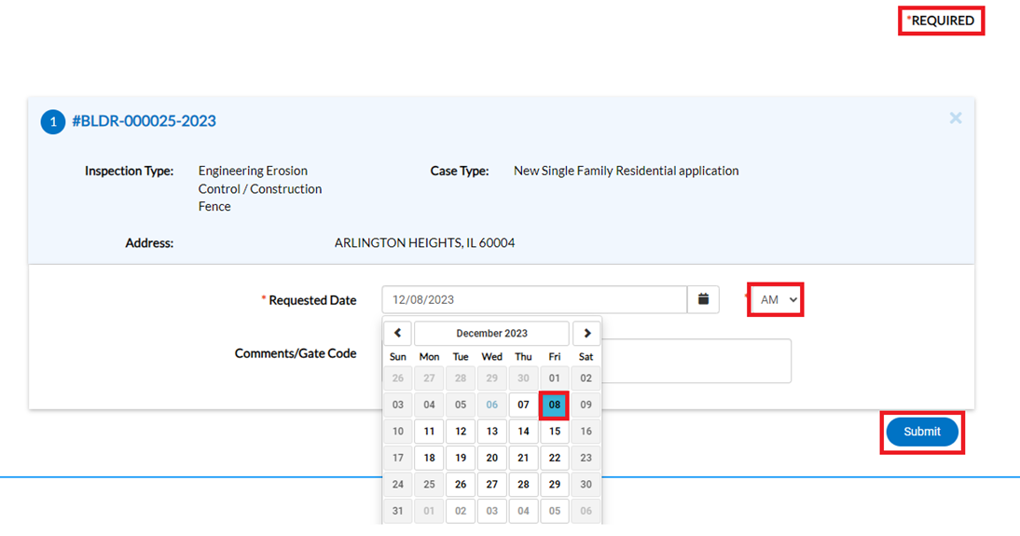
Citizen Self Service Permit Management
Step 7: Scheduling Inspections
Inspections available to be requested will show under Available Actions and in the Workflow
To request an inspection:
Select “Request”
Select a Requested Date from the calendar
Select AM or PM preferred
Select “Submit”

Slide 17
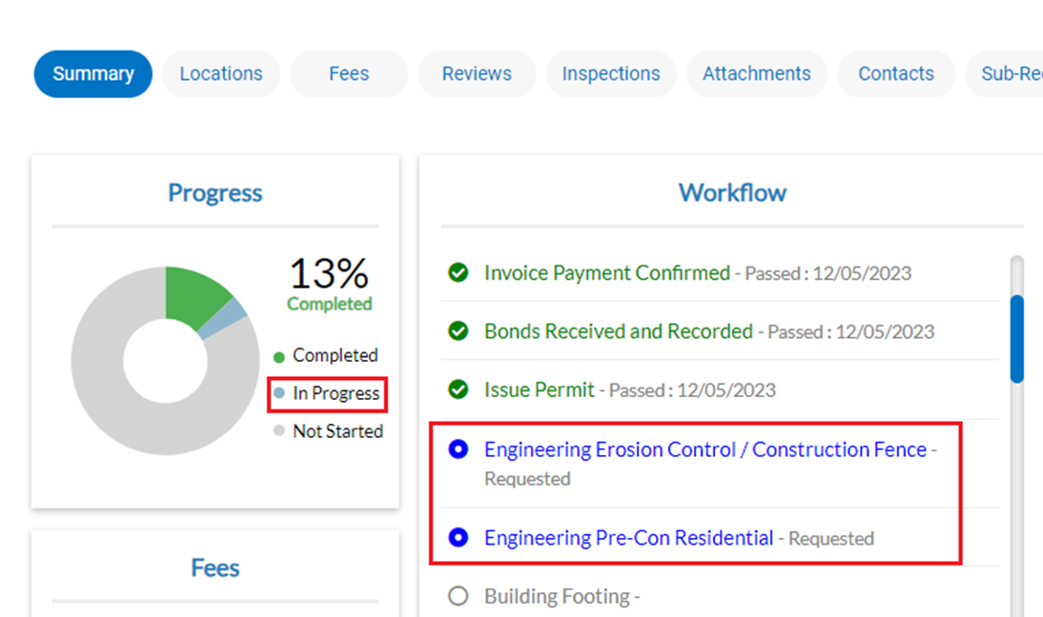
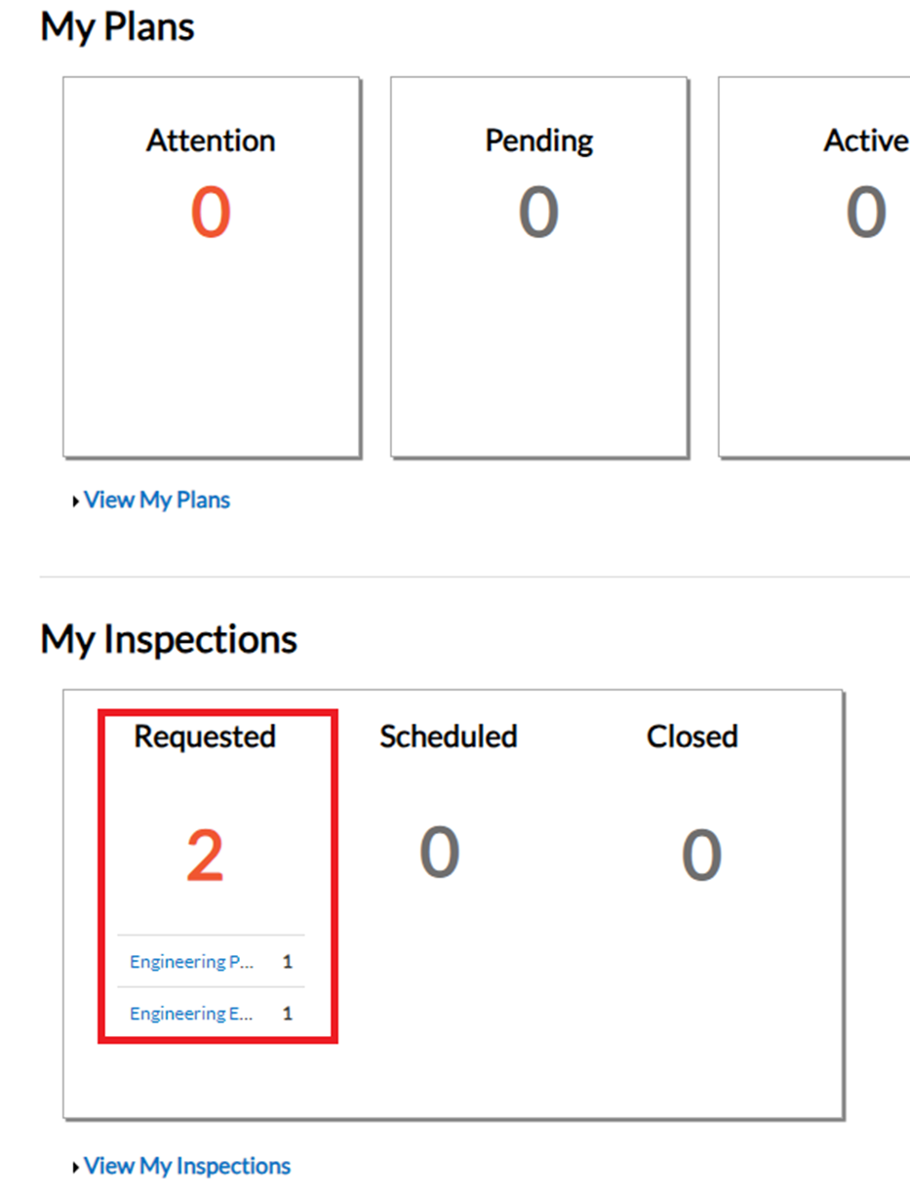
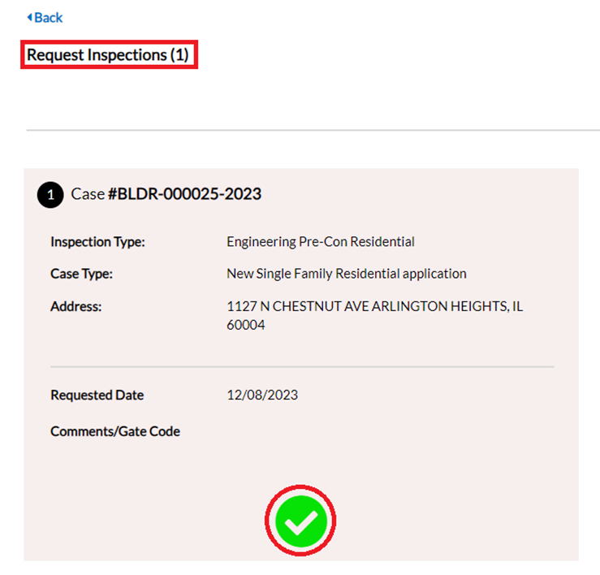
Citizen Self Service Permit Management
Step 7: Scheduling Inspections cont.
Green check will confirm inspection has been requested
NOTE: Inspections requested will appear in the My Inspections section of the Dashboard and will also be shown in the Workflow and Inspections tab

Slide 18
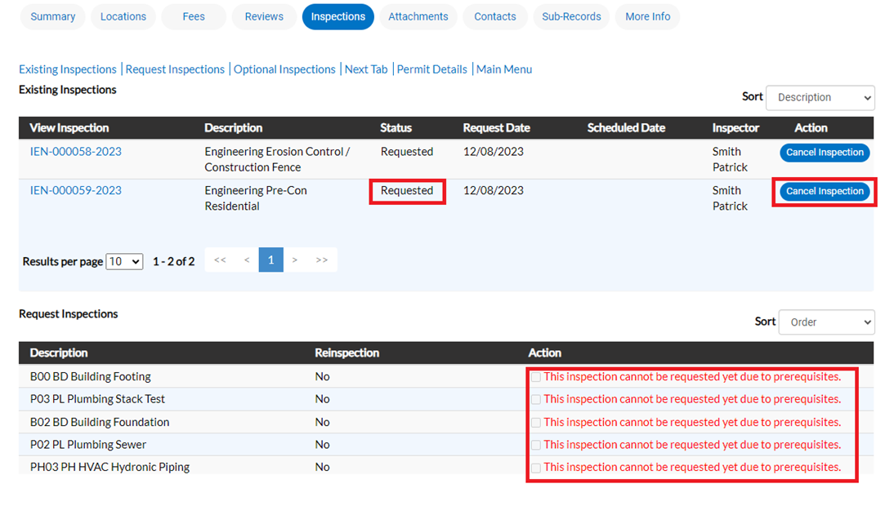
Citizen Self Service Permit Management
Step 7: Scheduling Inspections cont.
All inspections will be shown on the “Inspections” tab, and Inspections can be canceled by selecting “Cancel Inspection”
NOTE: The system will not allow certain inspections to be scheduled until the prerequisite inspections are complete in the Workflow

Slide 19
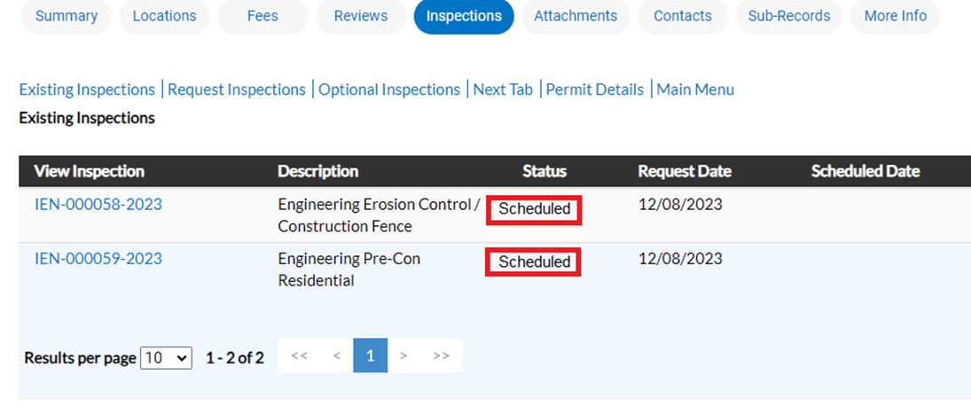
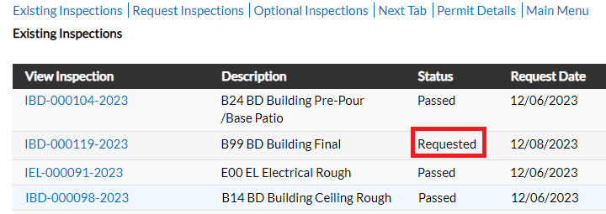
Citizen Self Service Permit Management
Step 7: Scheduling Inspections cont.
Inspections requested will be reviewed by Village staff
NOTE: Once confirmed, the Workflow and My Inspections will be updated from “requested” to “scheduled”

Slide 20
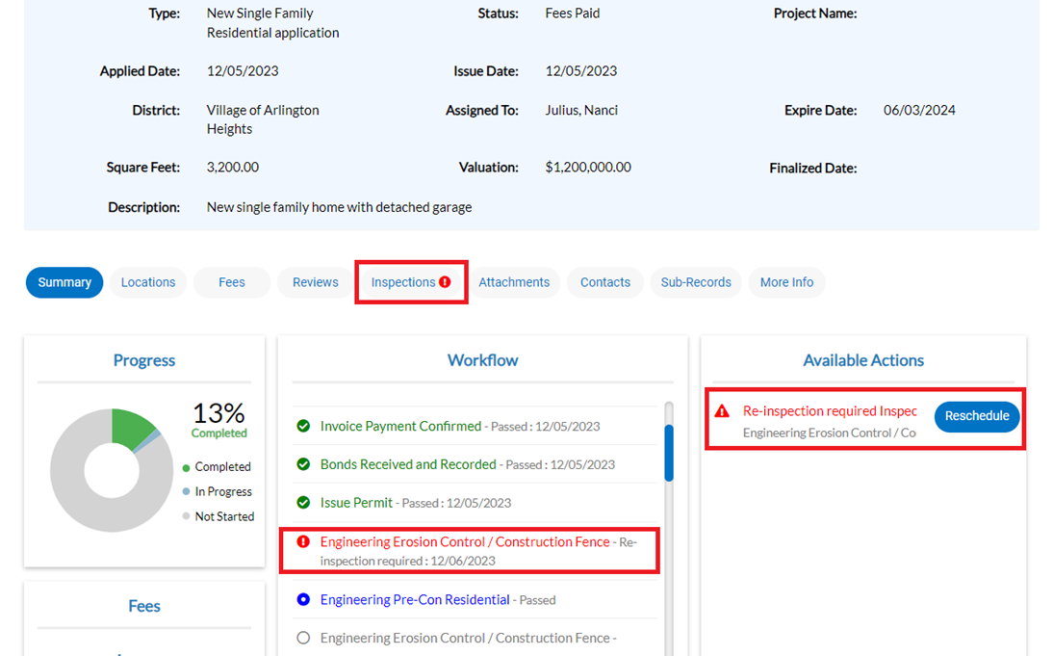
Citizen Self Service Permit Management
Step 7: Inspections Results
Inspection process:
Village inspectors will complete the scheduled inspection
Results and comments can be entered in the field from a laptop or iPad
Results are visible in real time on your Dashboard
A failed inspection will automatically populate “Re-inspection required” under the Available Actions section
Reschedule the failed inspection

Slide 21
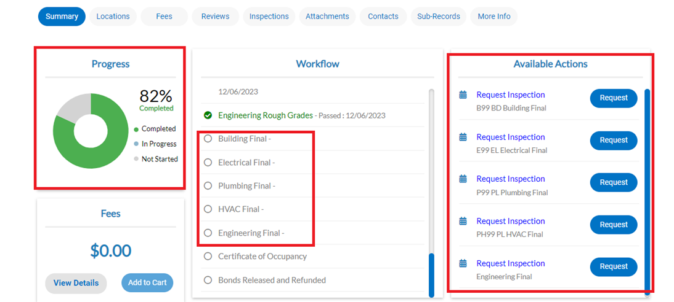
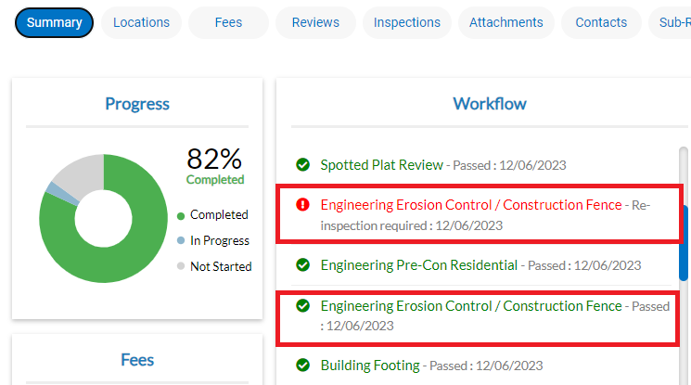
Citizen Self Service Permit Management
Step 7: Inspections results cont.
Once all prerequisite inspections are complete, final inspections can be scheduled
TheRRe
NOTE: Failed inspections will remain in the Workflow and will be shown in red, passing inspections shown in green
NOTE: Progress wheel will reflect the status of Workflow as Completed, In Progress, and Not Started

Slide 22
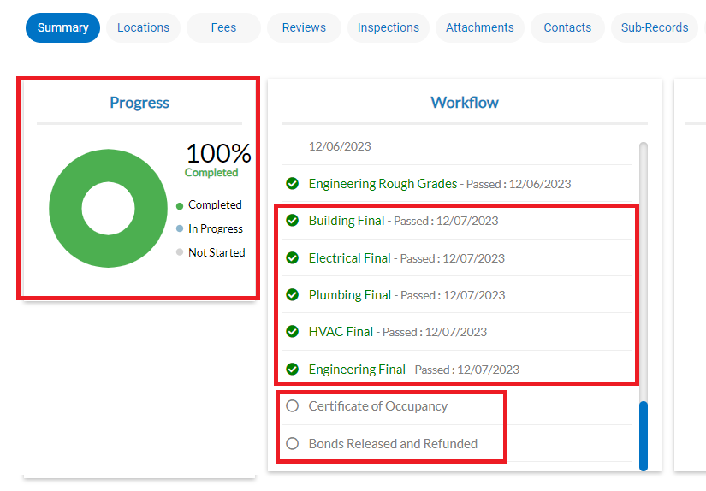
Citizen Self Service Permit Management
Step 8: Final Inspections
Final inspections are scheduled in the same manor
Steps to complete the project:
Village staff will review the project to confirm all final inspections passed
The Certificate of Occupancy will be approved
The Bonds Released and Refunded

Slide 23
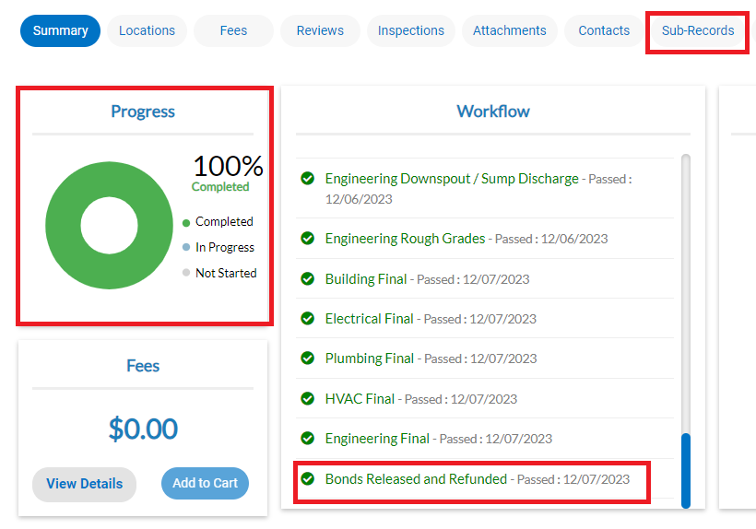
Citizen Self Service Permit Management
Certificate of Occupancy
NOTE: Workflow will update to reflect that the bonds were released and refunded. Once issued, the Certificate of Occupancy will be located in the “Sub-Records” tab on the permit management homescreen
NOTE: Many permits will not require bonds or a Certificate of Occupancy (CO). If a bond or CO are not required, your project is complete once all final inspections have passed.

Slide 24
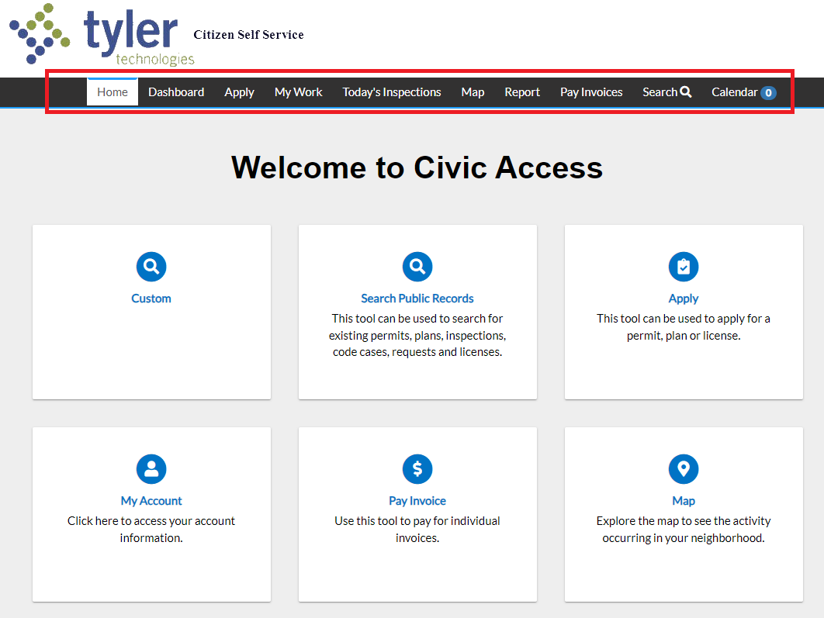
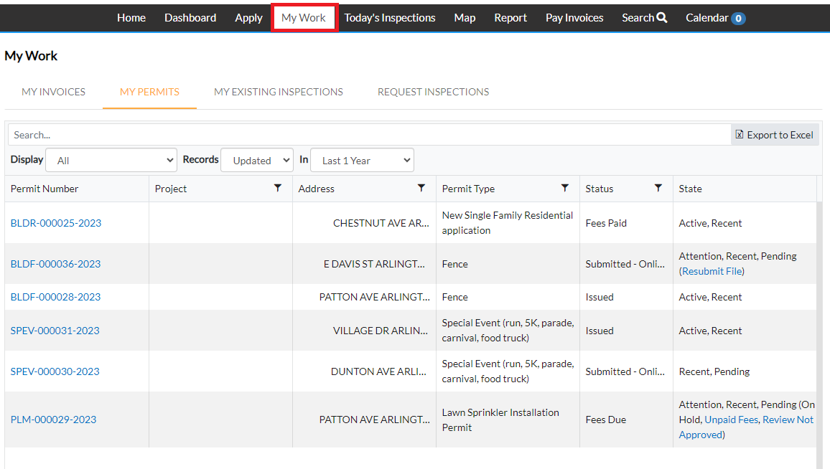
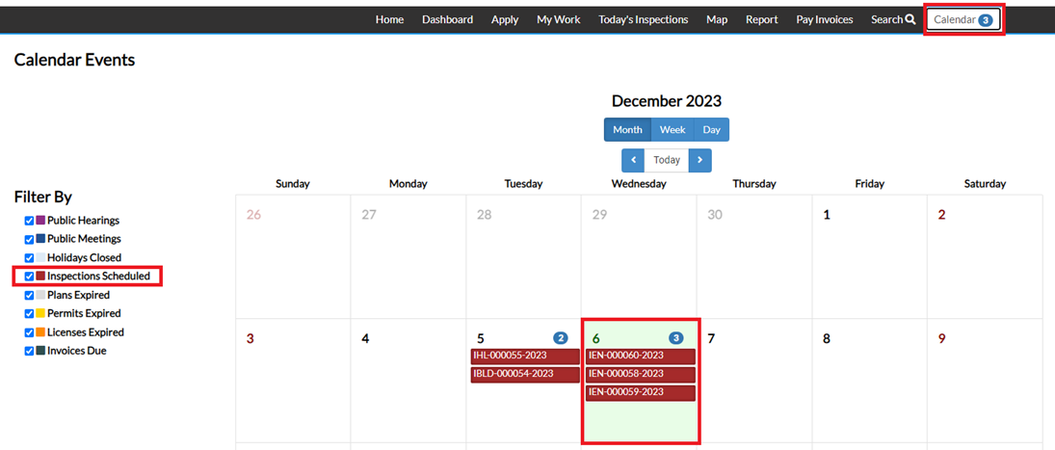
Citizen Self Service Permit Management
Overview
Landing Page & Top Menu Bar in Citizen Self Service

Slide 25
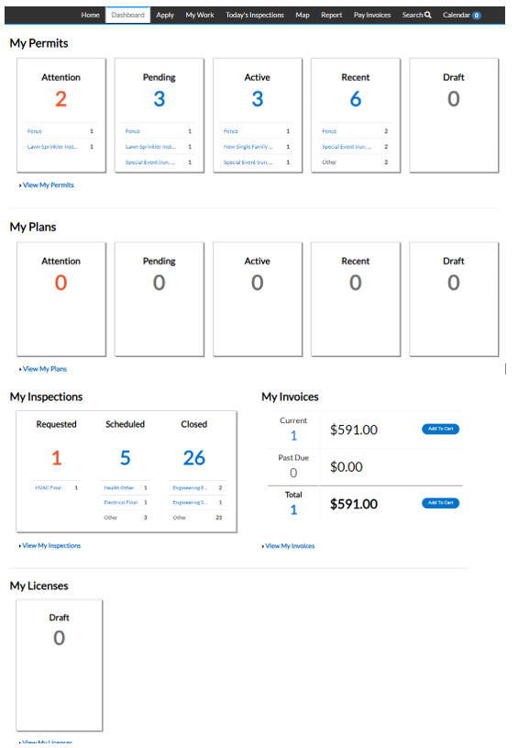
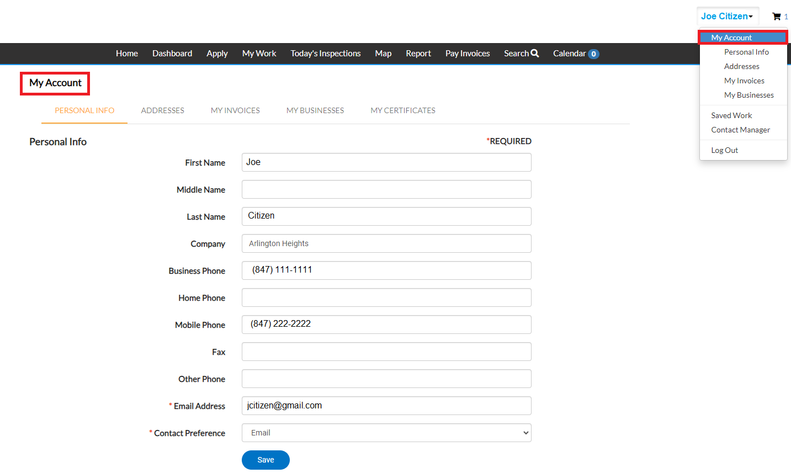
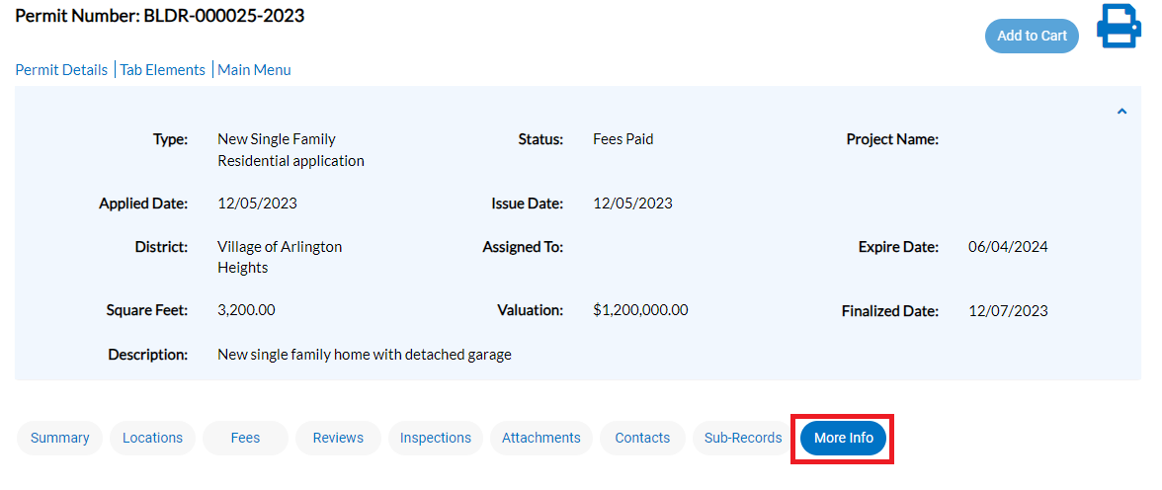
Citizen Self Service Permit Management
Overview cont.
More Info tab shows all information from the permit application
Account information can be viewed and updated

Slide 26
Citizen Self Service Permit Management
Thank you!

